Slide 1
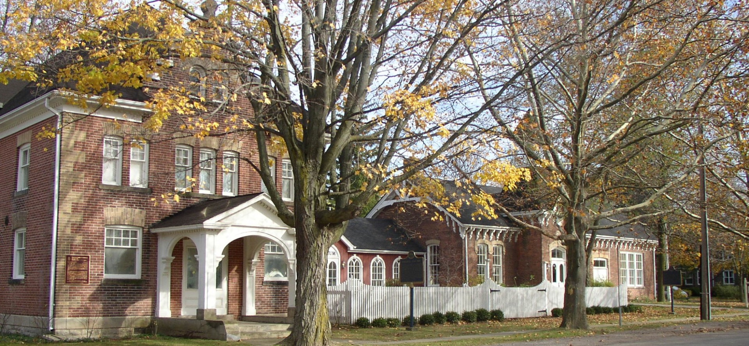

COSC 4P02- Software Engineering II
AR App Development for NOTL Museum

Slide 2
CONTENTS
1
2
Why AR application for NOTL Museum?
What is Augmented Reality
3
4
Tools for AR developement
Our Current Progress
5
6
Plans for future sprint
7
8
9
10

Slide 3
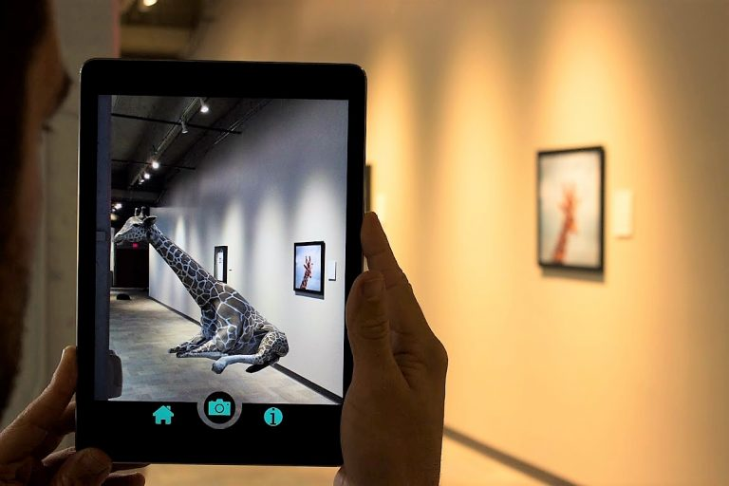

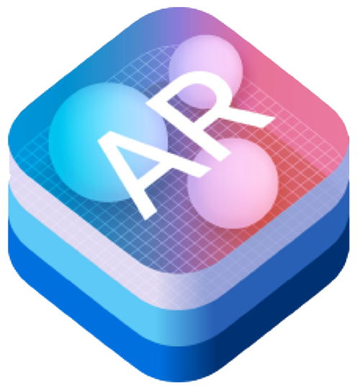
WHAT IS AUGMENTED REALITY?
Augmented reality is the technology that expands our physical world i.e. real-time interaction with audio, video, graphics.

Slide 4

Why AR application for NOTL Museum?
Museum have had same business model for decades, it needs some innovation. AR brings innovation.
For education purpose, its easier to learn.
increase engagement.

Slide 5



Tools for AR Development
Figma
Unity
React-Native

Slide 6

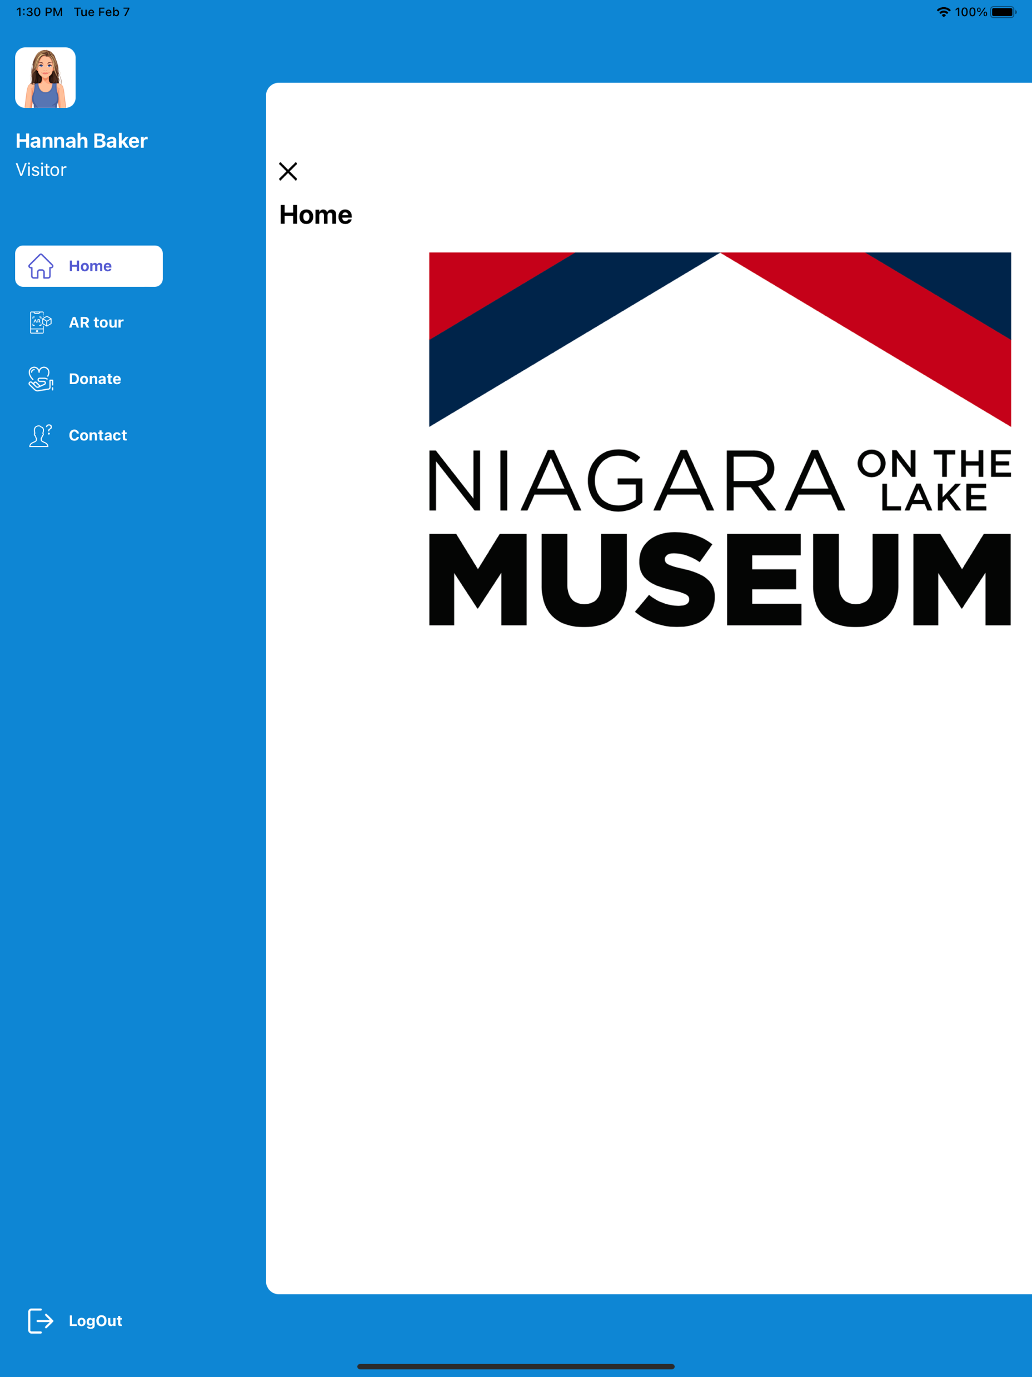
Our Current Progress

Slide 7
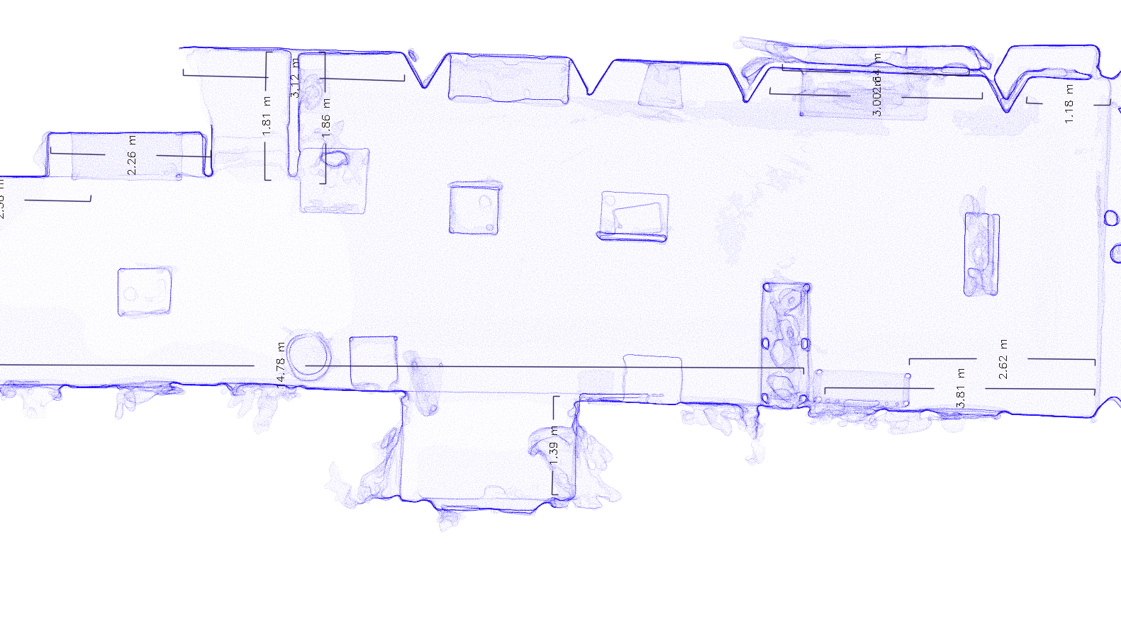
3D Model

Slide 8
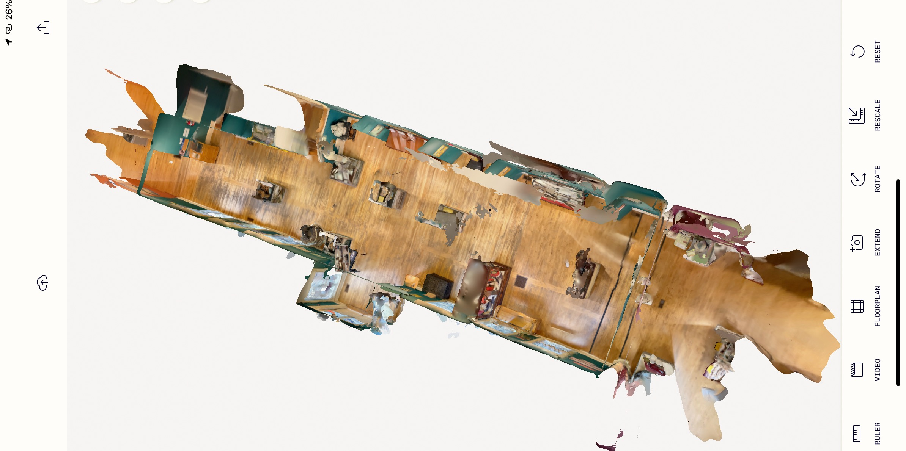

Slide 9
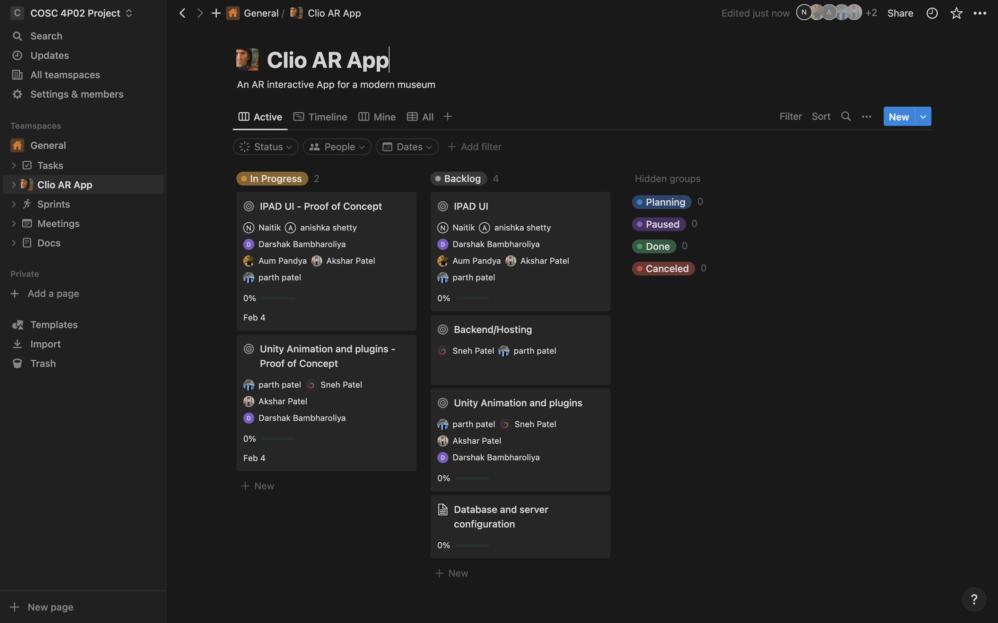
Plans for future sprint

Slide 10

Thank You

